Slide 1
HTML5 – Mid and Advanced
Automated Testing with Jasmine
18th of September, 2013

Slide 2
"Before software can be reusable it first has to be usable.“
-- Ralph Johnson
(Design Patterns)

Slide 3
Tests & Jasmine
Tests types: smoke tests, integration tests, user acceptance tests, regression tests and unit tests
Jasmine is a unit testing framework, ideally suited to run unit tests and regression tests
Notes:
Jasmine.js: http://pivotal.github.io/jasmine/
Jasmine.js basic configuration: https://github.com/pivotal/jasmine/downloads

Slide 4
Jasmine Framework
Jasmine is a behavior-driven development framework for testing JavaScript code (e.g. write use-cases focusing on human terms rather on code assertions)
Jasmine basics:
- suites (describe) and specs (it)
- specs setup (beforeEach, afterEach)
- fixtures (jasmine-jQuery)
- matchers (default & jasmine-jQuery)
- mocking and stubbing with spies
- asynchronous support (runs, waitsFor)

Slide 5

Suites (describe) and specs (it)
describe(“My Test Suite”, function() { … }) sets up the name of the test suite and executes the specs inside the function
it(“My Spec”, function() { … }) sets up the title for the spec and executes the test
describe("toBe", function () {
it("should be a div", function () {
expect($('<div />')).toBe('div');
});
});

Slide 6

Suites (describe) and specs (it)
1.suites-and-specs-setup.js

Slide 7

Specs setup (beforeEach, afterEach)
beforeEach function is called once before each spec in the describe is run and the afterEach function is called once after each spec
describe("toBeChecked", function () {
beforeEach(function () {
setFixtures('\
<input type="checkbox" id="checked" checked="checked" />\n\
<input type="checkbox" id="not-checked" />');
});
it("should pass on checked element", function () {
expect($('#checked')).toBeChecked();
});
it("should pass negated on not checked element", function () {
expect($('#not-checked')).not.toBeChecked();
});
});

Slide 8
Specs setup (beforeEach, afterEach)
1.suites-and-specs-setup.js

Slide 9

Fixtures (jasmine-jQuery)
The fixture is being loaded into <div id="jasmine-fixtures"></div> container that is automatically added to the DOM
Fixtures container is automatically cleaned-up between tests
describe("toBeChecked", function () {
beforeEach(function () {
setFixtures('\
<input type="checkbox" id="checked" checked="checked" />\n\
<input type="checkbox" id="not-checked" />');
});
it("should pass on checked element", function () {
expect($('#checked')).toBeChecked();
});
it("should pass negated on not checked element", function () {
expect($('#not-checked')).not.toBeChecked();
});
});

Slide 10
Fixtures (jasmine-jQuery)
2.jasmine-jquery-fixtures.js

Slide 11
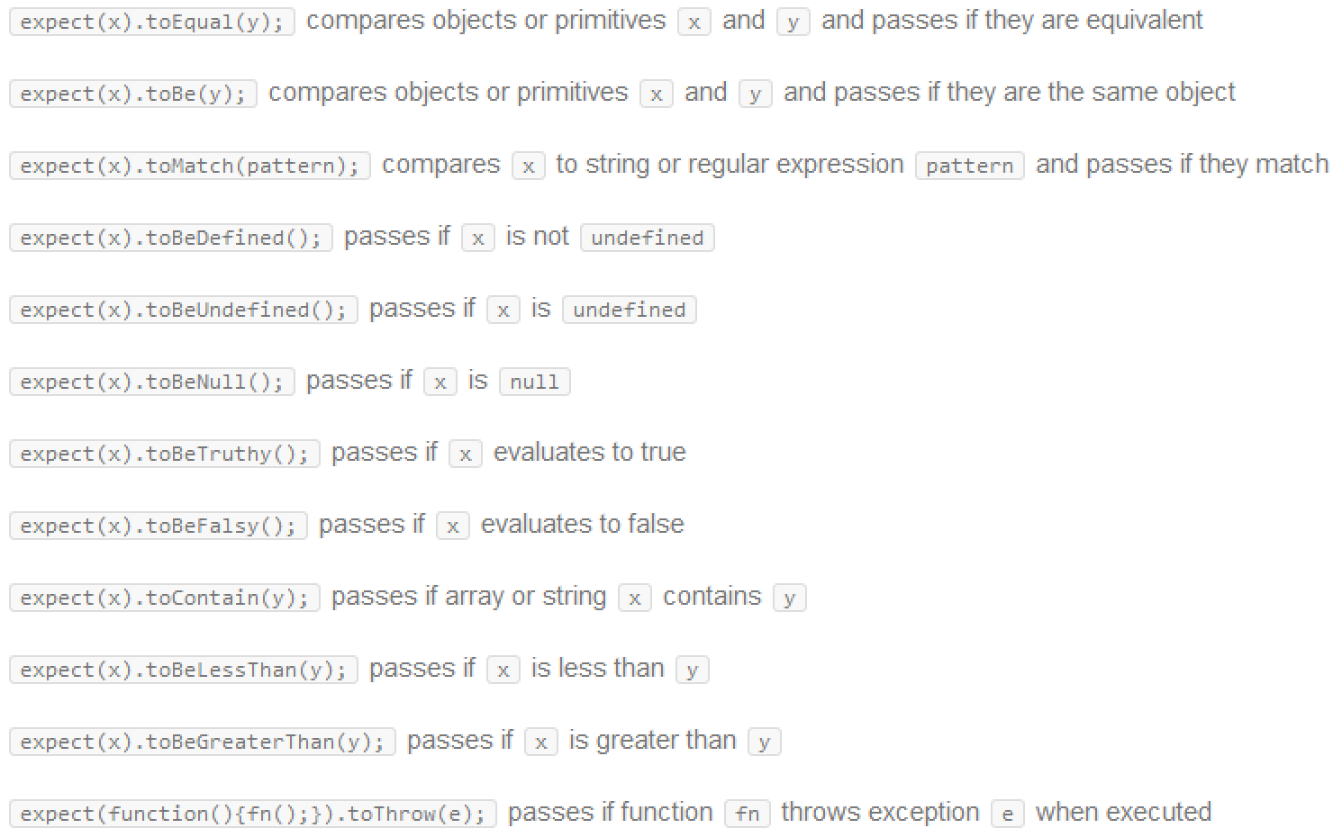
Jasmine Matchers

Slide 12
Jasmine jQuery Matchers
toBe(jQuerySelector)
  e.g. expect($('<div id="some-id"></div>')).toBe('div')
  e.g. expect($('<div id="some-id"></div>')).toBe('div#some-id')
toBeChecked()
  only for tags that have checked attribute
  e.g. expect($('<input type="checkbox" checked="checked"/>')).toBeChecked()
toBeEmpty()
toBeHidden()
toHaveCss(css), toBeSelected(), toBeVisible(), toContain(jQuerySelector), toBeMatchedBy(jQuerySelector), toExist()

Slide 13
Jasmine Default and jQuery Matchers
3.jasmine-default-and-jquery-matchers.js

Slide 14
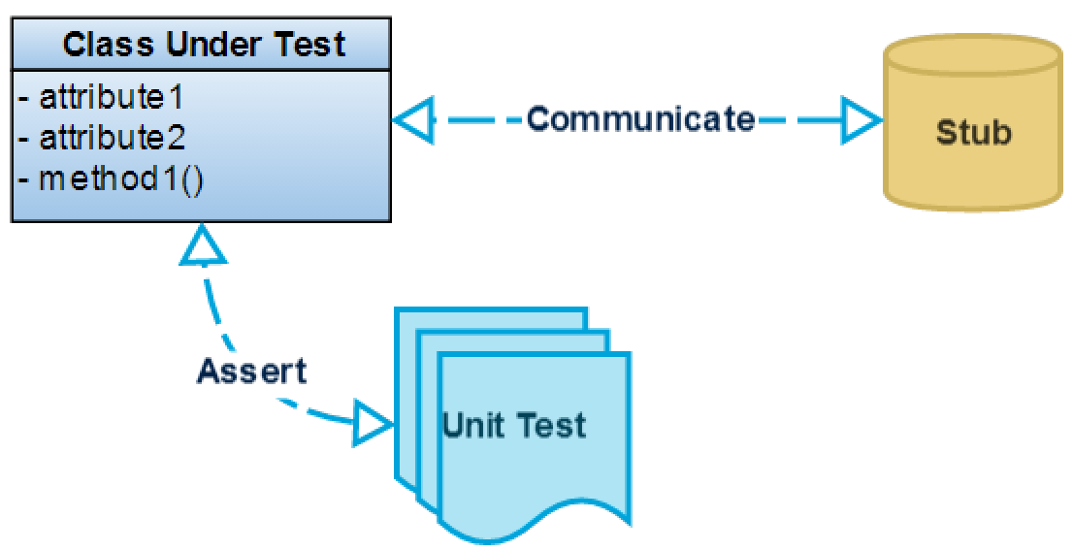
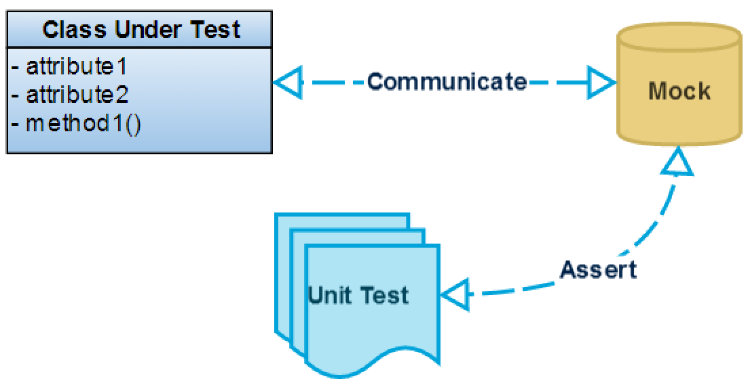

Mocking and stubbing with spies
In Jasmine, mocks are referred to as spies
There are two ways to create a spy in Jasmine:
- spyOn() -> used when the method exists on the object
- jasmine.createSpy() -> returns a new function
Stubbing
Mocking
Stubs lend themselves more naturally to state based unit testing and mocks to interaction based unit testing.

Slide 15
Mocking and stubbing with spies
4.mocking-and-stubbing-with-spies.js

Slide 16
Asynchronous support (runs, waitsFor)
Jasmine deals with asynchronicity through runs() and waitsFor()
- runs() blocks execute procedurally
- waitsFor() provides a better interface for pausing your spec until some other work has completed

Slide 17
Asynchronous support (runs, waitsFor)
5.asynchronous-support.js

Slide 18
Jasmine Maven Plugin
Jasmine Maven Plugin helps incorporate JavaScript tests in an continuous integration server without requiring any browser
Goals:
- jasmine:bdd -> execute specs in a web browser
- jasmine:test -> execute specs using Selenium Web Driver. Uses HtmlUnitDriver for head-less execution by default

Slide 19
Jasmine Maven Plugin
AW - Demo
Notes:
Go to: repository\trunk\components\monitoring\comlayer
Run: mvn jasmine:bdd or mvn jasmine:test

Slide 20

Learn through Koans
“A kōan is a story, dialogue, question, or statement, which is used in Zen-practice to provoke the "great doubt", and test a student's progress in Zen practice.” Wikipedia

Slide 21
Exercises
Learn Jasmine.js through Koans
Notes:
Exercises: https://github.com/mrdavidlaing/javascript-koans

Slide 22
Thank you!
Cosmin Nicula
Blog: http://cosmi.nu
GitHub: https://github.com/cosminnicula
Twitter: https://twitter.com/cosminnicula
Notes:
Further reading:
- http://www.zealake.com/wp-content/uploads/2013/07/advanced-jasmine.pdf
- https://github.com/larsthorup/jasmine-demo-advanced
- http://shop.oreilly.com/product/0636920028277.do

